Slide 1
Utility of Dynamic Bayesian Networks based Data generators
Highlighting problems that DBN-based data generator would solve

Slide 2
Current Setup and its Challenges
Highlighting the problems that DBN-based data generator can solve

Slide 3




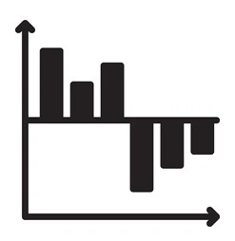

Current Setup for Validation
Dataset
Data Dictionary
Forecasts
Data-based validation
Codebase to perform:
Feature engineering
Modelling
Feature Contributions
Business/Human Validation

Slide 4
Current Setup for Validation (Contd.)
We have a dataset, along with the data dictionary, from client.
We try to see if the contributions from the features make business sense or not.
The features often include complex engineered features whose contributions are hard to ascertain.
For example, trend and seasonality, base-price, promotional discount etc. are derived out of complex calculations on the sales quantity.

Slide 5
Scenario I – Incorrect notions about feature impacts
The standard regression/forecasting setup is applied. The feature impacts are read-off from the contributions reported by the model.
Promotional discounts give a positive contribution to sales which makes business sense.
Business proceeds with increasing the discount percentage. But it does not increase the sales.
Are we sure that the contributions reported against discounts were truly reflecting its real-world impact? In what setup are they reliable, and where are they not?

Slide 6
Scenario II – Not enough scope for testing
A modelling setup is finalized based on its test set performance. This is a robust strategy for non-timeseries scenarios.
For timeseries scenarios the idea is that with the passage of time, a retraining with new data would be triggered and forecasts generated. The original test set performance would indicate the accuracy of such forecasts.
However, a model monitoring setup should keep recording the forecast performances for multiple cycles, over a certain amount of time. Only then the true efficacy of the modelling strategy can be estimated.

Slide 7
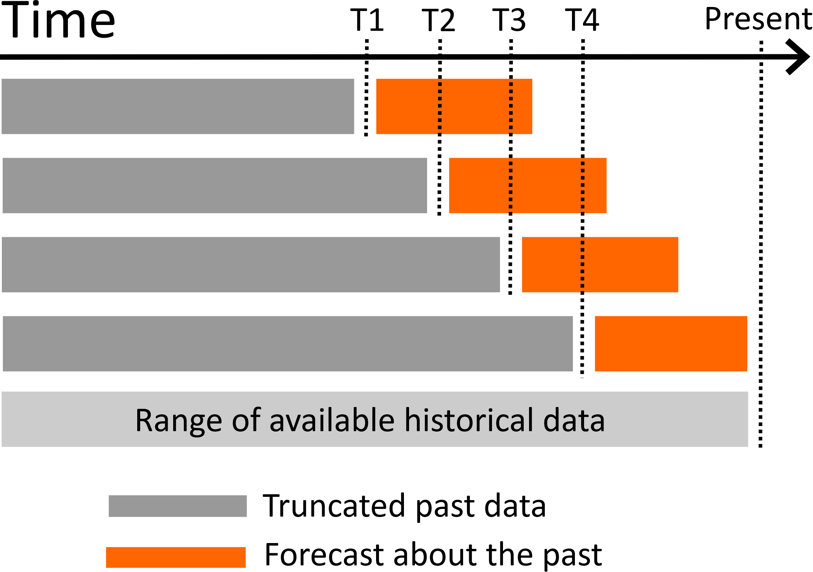
Ideal test setting for time-series data
Greyed out span actually accommodates training + validation (for tuning) sets.
Span of historical data should be large.

Slide 8
Scenario II – Not enough scope for testing (contd.)
Thus, a forecasting setup inherently requires a long time to gain confidence.
The other option is simulating multiple cycles of retraining-forecasting-validating with the training data itself. Seldom such amounts of data are available that would allow for this, after accounting for the necessary amount of training and test sets.

Slide 9
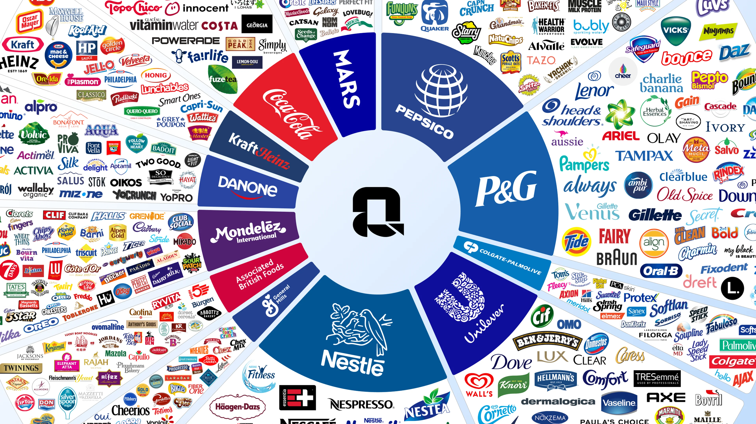
Challenge III – Testing generizability of solution strategies across industry
Standard strategies for modelling, feature engineering etc. are in place for CPG industry projects.
To test the generalizability of those approaches across the CPG industry, first we should have the opportunity to work with the wide variety of clients across the industry.
That opportunity is seldom present.

Slide 10
How to think of DBN Data Generator
A broad perspective to understand its applications

Slide 11
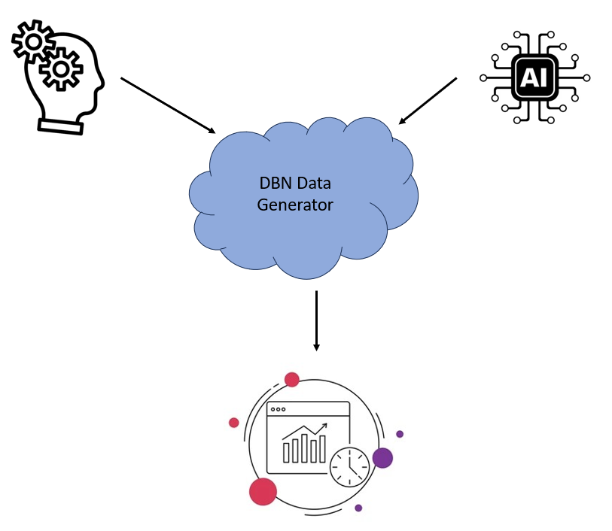
DBN Data Generator – Proxy for Real World
DBN Data Generator is a data generating mechanism where one can explicitly specify the details of the data generating mechanism. Out of it multivariate time-series data would be generated.
The specifications can be from human end or AI-generated.
The main difference of this from other available synthetic data generators, is its capability to incorporate time dependence in the data generating mechanism, just like the way it happens in real world.

Slide 12
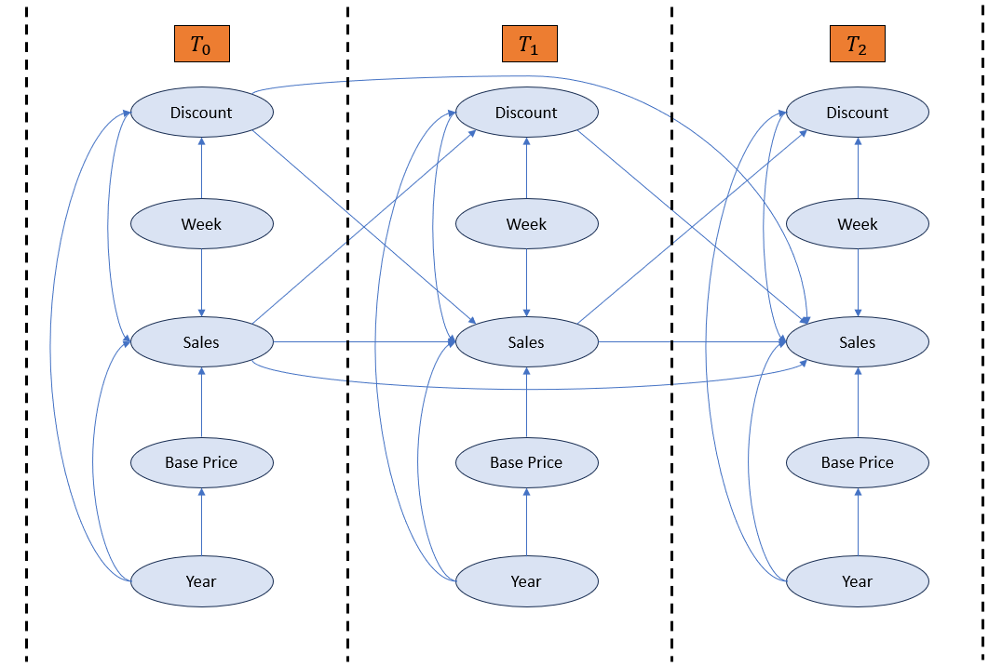
Detailed Data Generation Process
The temporal dependencies are incorporated naturally in the data generation process. That is, as it happens in real world.
It is flexible so it can be adjusted to replicate any real-world scenario.

Slide 13



$$T_{0}$$
$$T_{1}$$
$$T_{2}$$
Discount
Discount
Discount
Week
Week
Week
Sales
Sales
Sales
Base Price
Base Price
Base Price
Year
Year
Year

Slide 14
How DBN solves the problems
Details of the DBN setup that helps address each of the problems

Slide 15
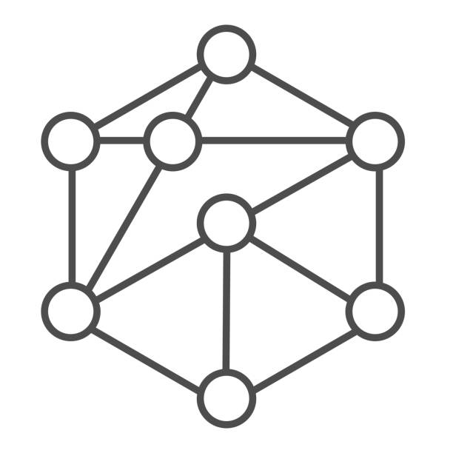
Setup with DBN based Data Generator
DBN based Data Generator
Forecasts
Future Data
Dataset
Codebase to perform:
Feature engineering
Modelling
Feature Contributions

Slide 16
Setup with DBN based Data Generator (Contd.)
The DBN Generator generates the data according to a given setting.
It allows continuous generation of new data which is used for testing forecast quality.
A compete knowledge of the data generating mechanism allows calculation of original contributions which is tallied against those from model output.

Slide 17
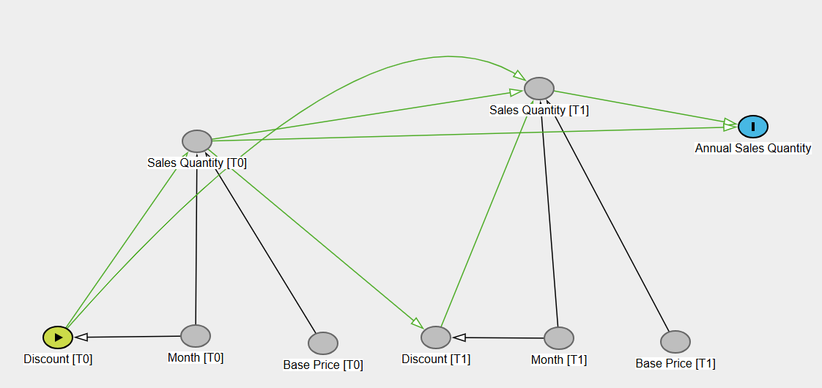
Example – Identifying original contributions
For example, contributions from discounts throughout the year, towards the annual sales, can be identified in real time.
The contributions derived from the modelling approaches, can be compared against these “original” contributions.

Slide 18
Example – Identifying original contributions (contd.)
Contributions are often required to have actionable insights. Based on the contribution of discount, a certain discount strategy is implemented expecting that the respective revenue change would be observed over time.
Hence it’s important to compare contributions from the model output against such causal impacts observed in the data generating mechanism.

